Slide 1
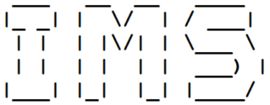
T1A3 – Terminal app
Richard Cho

Slide 2
AGENDA
Statement of Purpose
Features
Flowchart
Screenshots
Challenges

Slide 3
STATEMENT OF PURPOSE
IMS stands for Inventory Management System and it’s a simple terminal app that allows users to manage and store their inventory.
The target audience for this app are mainly small businesses and individuals.
Users can see this as a free alternative to accounting software such as MYOB (~ $30/month).

Slide 4
Features
Create
Save / Load
Update
Delete
Create new objects under the Inventory class. Objects will have the following attributes:
Name
ID
Price
Quantity
When an object is instantiated, their attributes will be saved as a CSV file and also a YAML file. The YAML files acts as a database and will be automatically loaded when we start the app.
Once objects have been created, we can update their attributes by reading the YAML database and altering the relevant values.
Read from the YAML file and remove an item from the list.

Slide 5
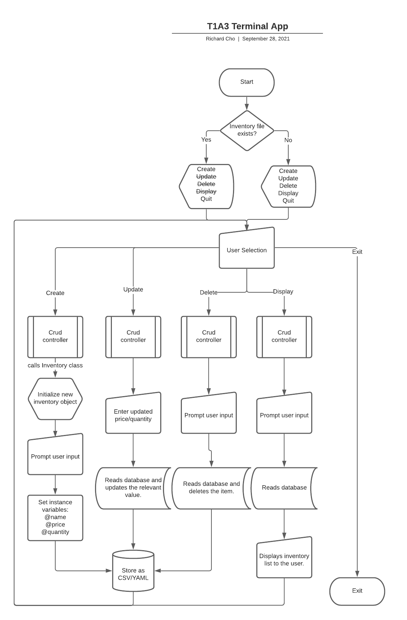
No
Yes

Slide 6
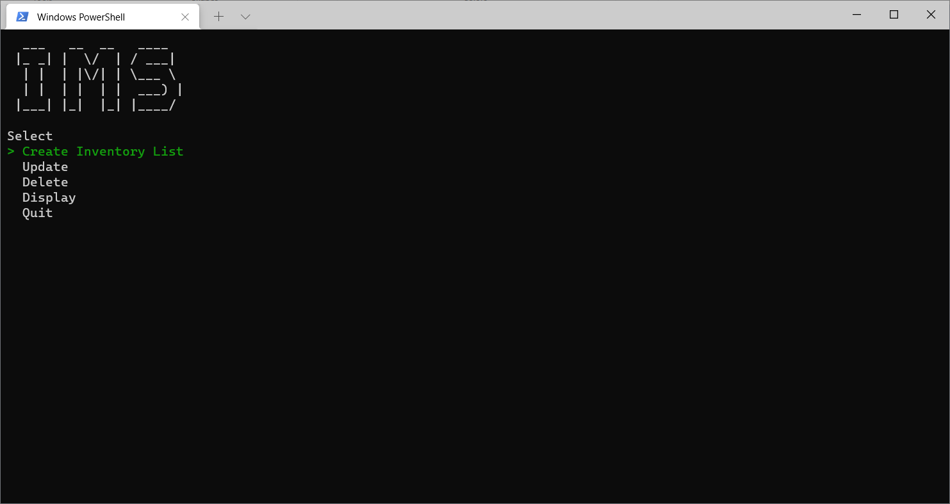
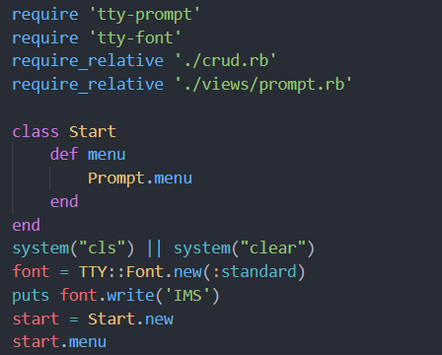
tty-font
tty-prompt

Slide 7
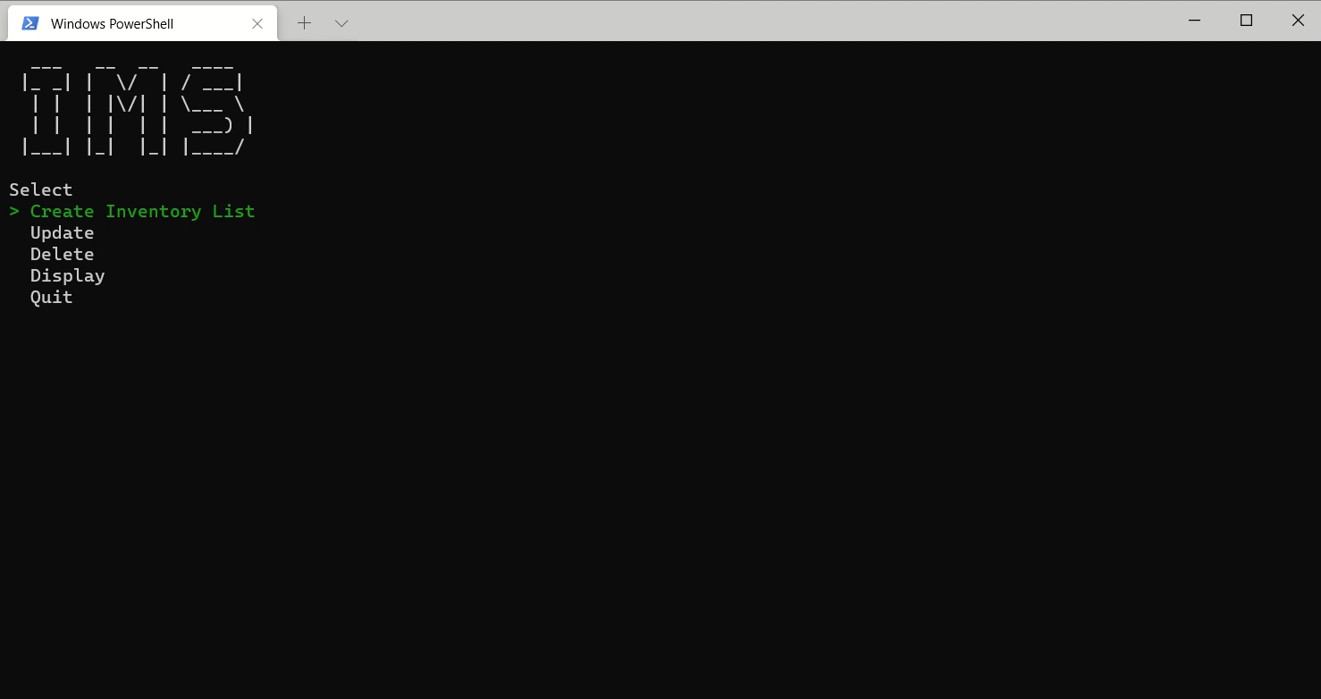
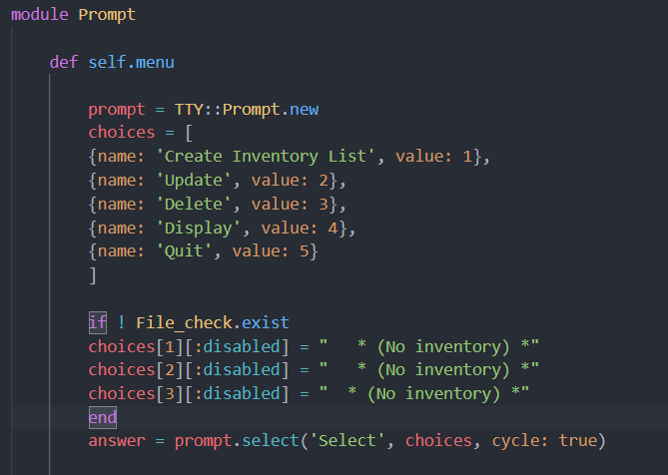
User can cycle
through the menu

Slide 8
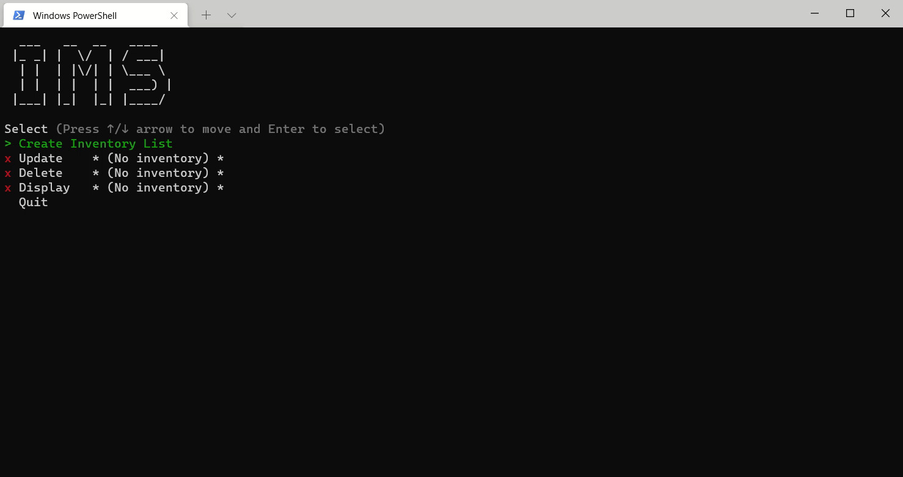
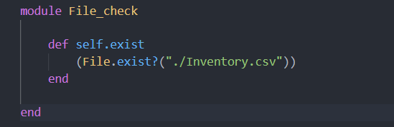
Some options will be disabled if no inventory is found.

Slide 9
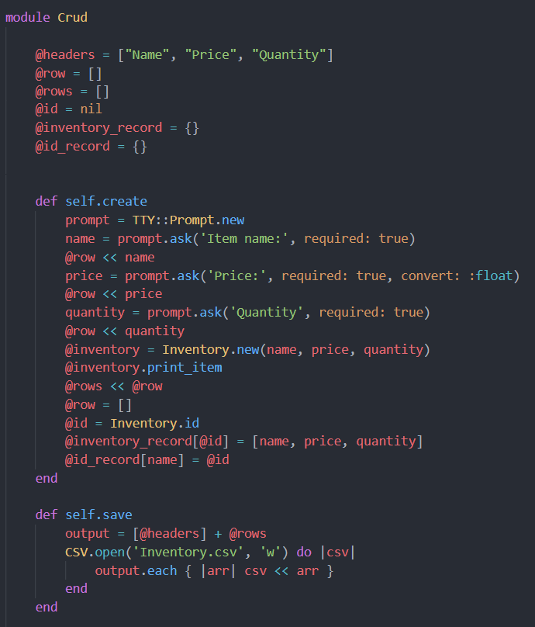

Slide 10
RuBY GEMS
TTY-Font
App logo
TTY-Prompt
Menu selection and prompts
TTY-Table
Displays the list of items as an ASCII table
CSV
Reading and writing .CSV files
YAML
Reading and writing .YAML files

Slide 11
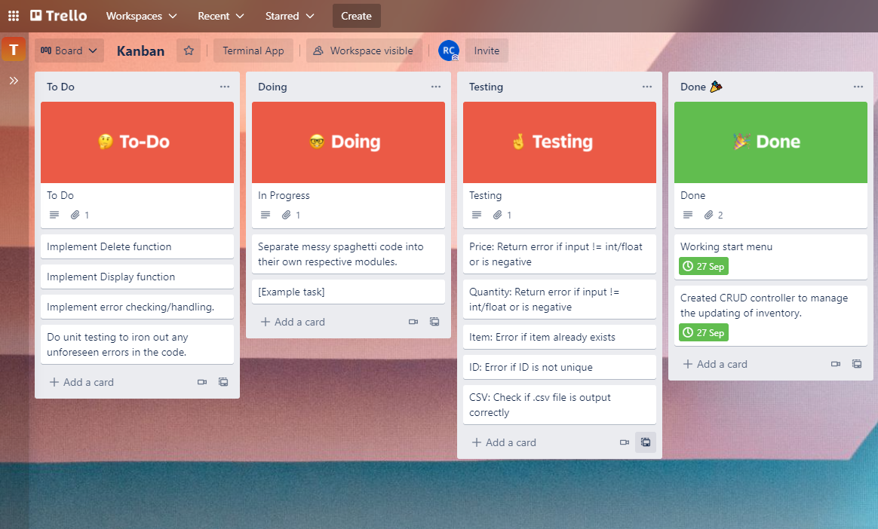

Slide 12
Challenges
Understanding OOP Concepts
Implementing features
Testing
Self
Classes
Modules
Trying to stay away from spaghetti code and separate them into separate files,
More features = more complexity = more time
Fixing errors
Error handling – Thinking of all the different ways a piece of code can break.
Making sure the app behaves the way it’s meant to.

Slide 13


